Slide 1


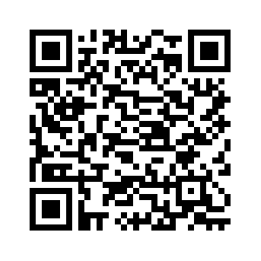
Open Collaboration in Educational Resources What We Can Learn from Open Source Development
Axel Klinger (TIB)
Hannover, Germany
OE Global Conference, 18th October 2023
Slides
Notes:
Throughout Germany, but also internationally, there are already numerous decentralized platforms for the exchange and joint further development of OER in all areas of education. However, as the number of sources on the web increases, so does the effort that teachers and learners have to find suitable content for their interests. The Open Educational Resources Search Index (OERSI) project addresses this problem by providing a central entry point for searching distributed repositories for Open Educational Resources in higher education. Since the beginning of 2020, the OERSI project has been developed as a jointly initiated and self-financed project by the North Rhine-Westphalia University Library Center (hbz) and the German National Library of Science and Technology (TIB) as open source and has been available since the summer of 2020 as a national, cross-institutional entry point with currently more than 38,000 Open Educational Resources in different languages. The entire development takes place openly on the GitLab platform at https://gitlab.com/oersi.
The modular and flexible technical infrastructure for collecting and transforming data offers the possibility of integrating a wide variety of sources, provided they have an API or a sitemap. In this way, the index is continuously expanded. The integration of new sources is mainly based on the Metafacture framework, a toolkit for processing semi-structured data with a focus on library metadata. It provides a versatile set of tools for reading, writing and transforming data. Beside the integration processes with Metafacture it is also possible to integrate new sources with any other programming language. In addition to centralizing the search offerings, it is also possible to integrate the search and search results into other portals via open interfaces for selected subsets of the OERSI. The state portals of North Rhine-Westphalia (ORCA.nrw) and Lower Saxony (twillo.de) are first examples of this integration.
With the current development, OERSI is aiming for greater international networking. In this sense, a mapping of multilingual search terms and a translation of the user interface with controlled vocabularies for the search filters is planned for implementation in the coming months. Currently, the search index is already available in German and English with translated vocabularies for subjects and materials. Interested platform operators are invited to participate in the Open Source development and may recommend additional sources for inclusion.
This session will describe the basic functionality of OERSI, demonstrate the reuse in other portals, and provide insight into the open source development process on GitLab. Another point to be demonstrated in this session is the connection of GitLab instances as distributed working environments for collaborative work on Open Educational Resources. GitLab can be used to collaboratively create, extend, and publish open educational materials in the form of lessons, courses, presentations, and scripts, and the environment provides numerous opportunities for collaboration in Open Science projects in addition to versioning and transparency. With the help of easy to setup templates and support for metadata maintenance, metrics for quality can also be integrated in a simple way. The approaches presented here are still under development but offer great potential for reuse in international projects.

Slide 2

Introduction
Technische Informationsbibliothek (TIB) https://tib.eu/en/ is Leibniz Information Centre for Science and Technology in Germany and University Library in Hannover
At TIB we are building infrastructure for Open Science and Open Education

Slide 3
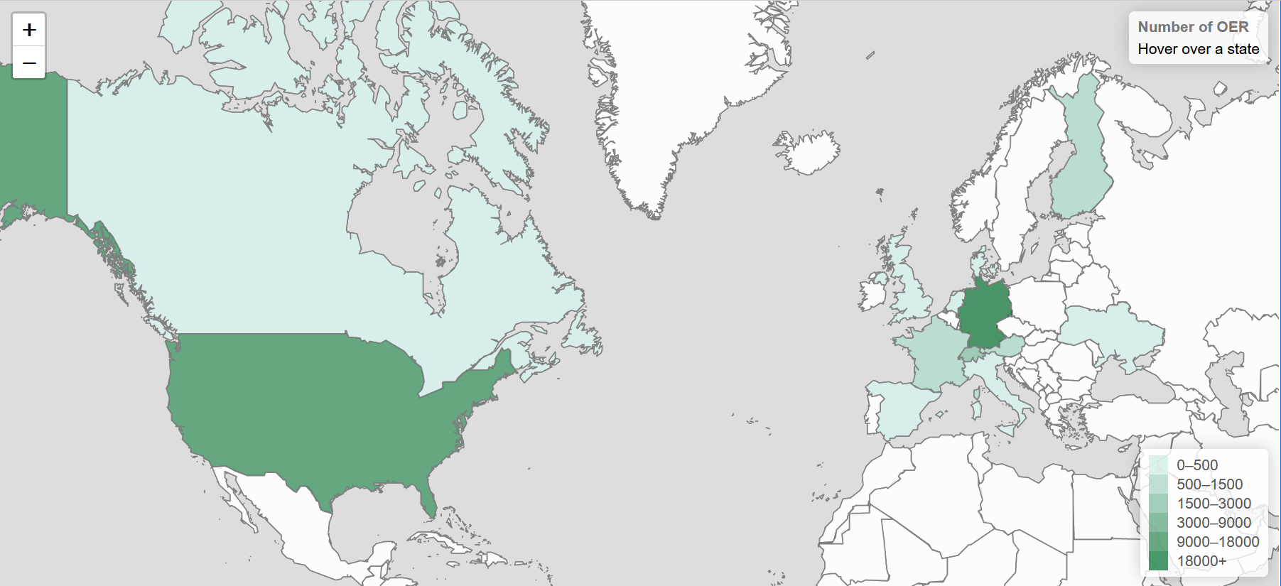
Introduction
2019 launched twillo https://twillo.de as Lower Saxony's OER portal for HE
2020 started the OER search index https://oersi.org to search on distributed repositories and provide an open API

Slide 4
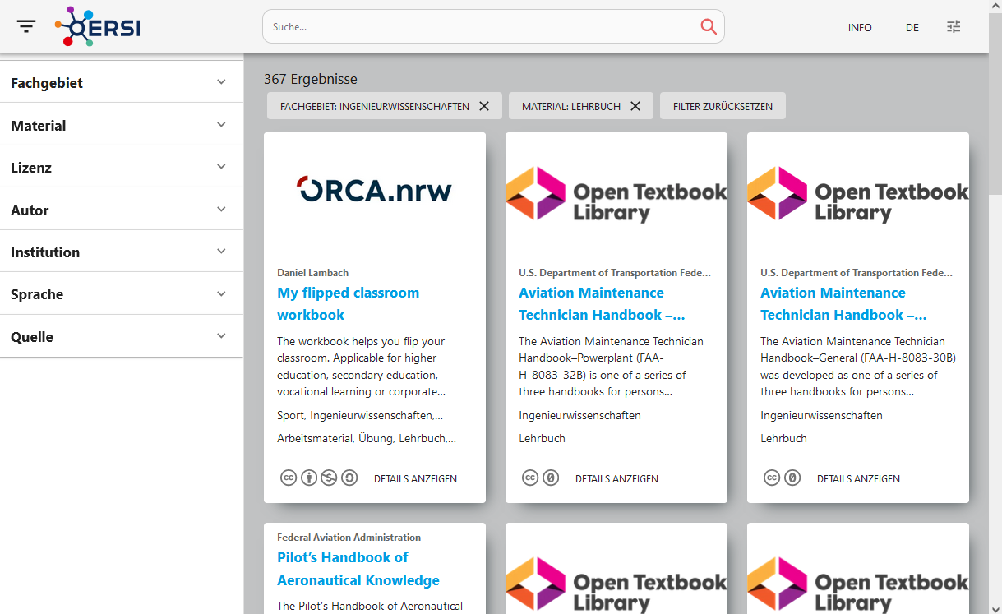
Introduction
With the collection in OERSI, the following questions arise
What are suitable working environments for cross-regional collaboration?
Which formats are particularly open (FAIR) and attractive for use and re-use?

Slide 5
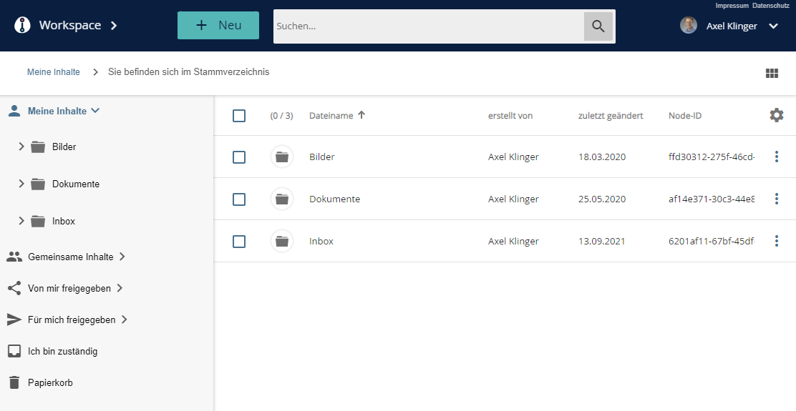
OER Providers - Working Environments?
Repositories
Storage locations for fixed versions as for classic publications
No working environment
Local or regional authentication
Document Management Systems
Shared file management
Focus on office documents
Local or regional authentication
Learning Management Systems
Closed environments
Materials (courses) are only conditionally compatible with other systems
Local or regional authentication

Slide 6
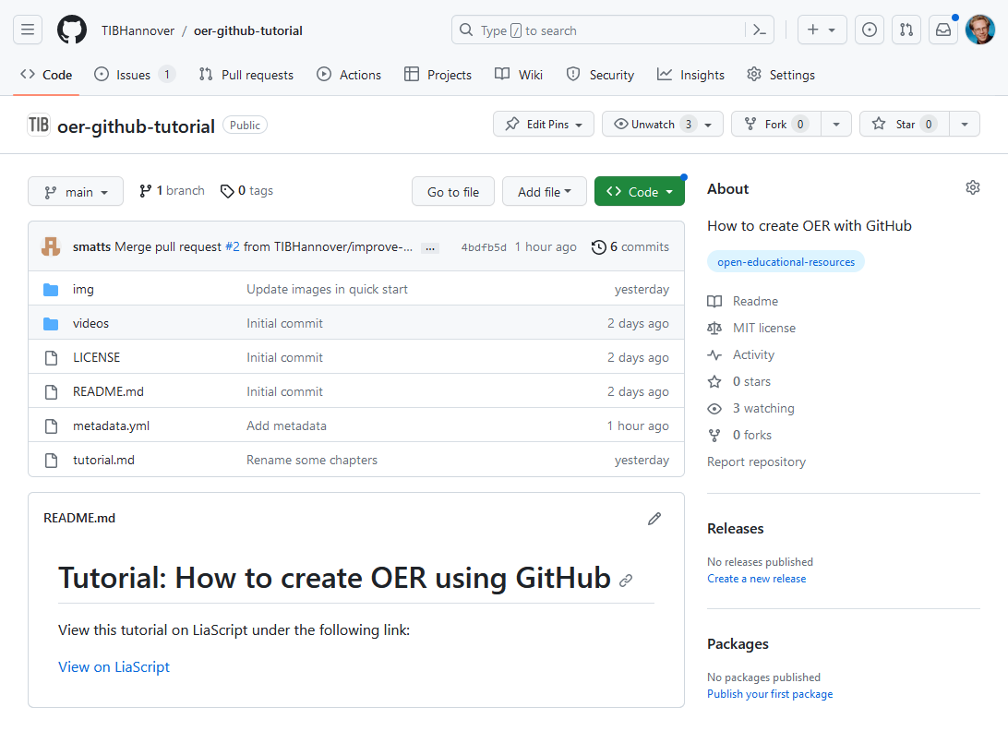
OER Providers - Working Environments?
Version Control Systems known from Software Development
Examples
GitHub https://github.com
GitLab https://gitlab.com
Plain text like Markdown, Latex etc
Current status and fixed versions
Integrated editors
Task planning for bug fixes and additions
Workflows for collaboration
Globally freely available for national or international collaboration

Slide 7
Open Source and OER
Open source software development has been established worldwide for decades with tools and workflows for international collaboration. OERSI itself is developed as open source software at https://gitlab.com/oersi.
What do open source software development and the development of open educational resources have in common?
Sources and results freely available and openly licensed
Coordinated collaboration on files
As far as possible no dependencies to (single) commercial products
Transparency about changes and decisions during further development

Slide 8
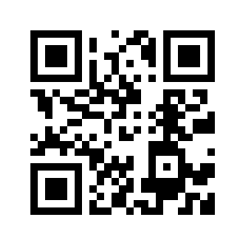
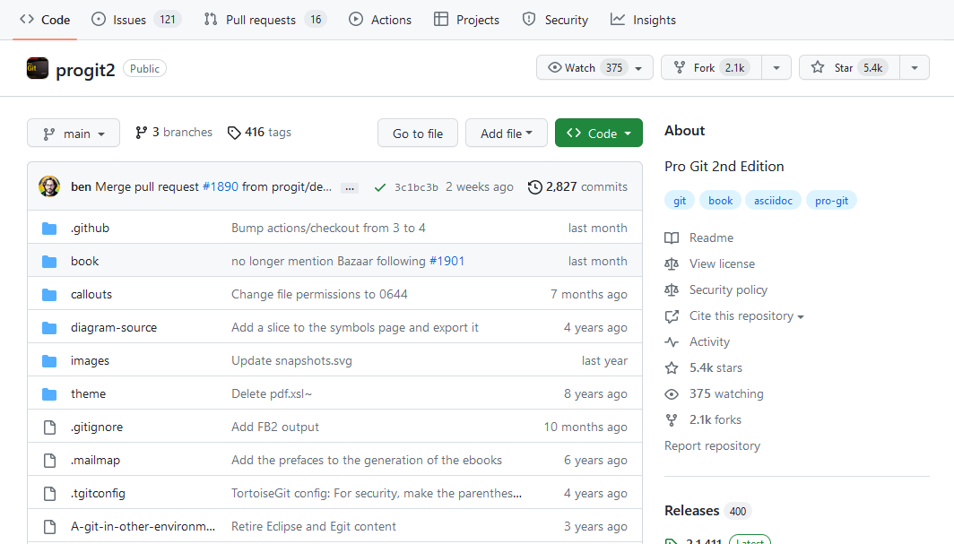
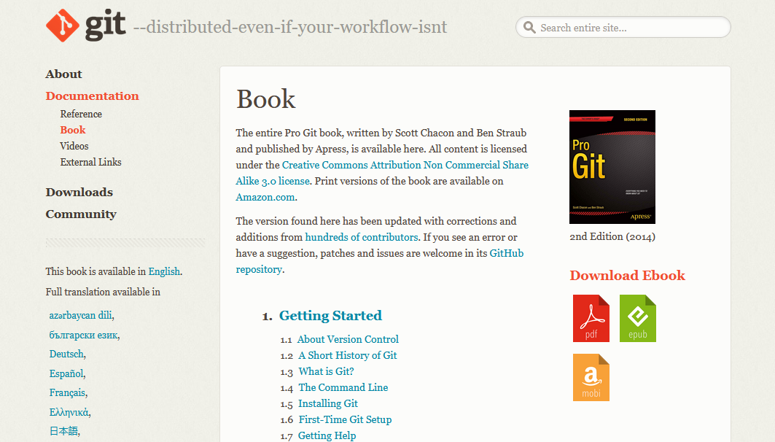
Open Source Textbook Example
Book „Pro Git“ on GitHub as a great example for Open Textbooks
Open Source with CC license
Printed version plus HTML, PDF, EPUB, MOBI
Collaboration on GitHub https://github.com/progit/progit2
Problem: complicated structure, not easy to reuse for beginners

Slide 9
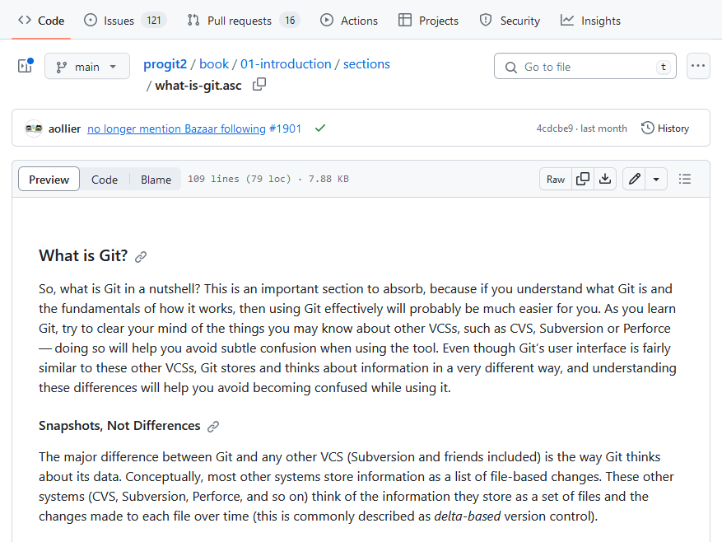
Open Source Development
A GitHub repository contains all of your code, your files, and each file's revision history. You can discuss and manage your work within the repository
https://docs.github.com/en

Slide 10
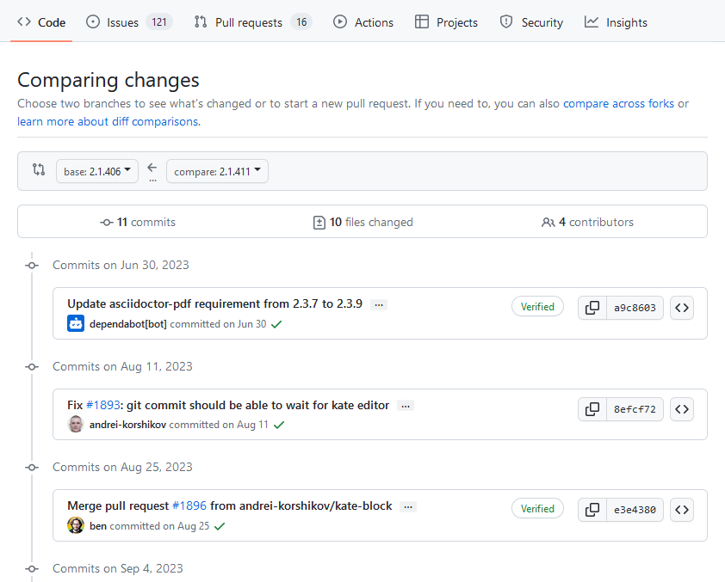
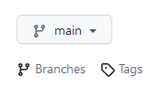
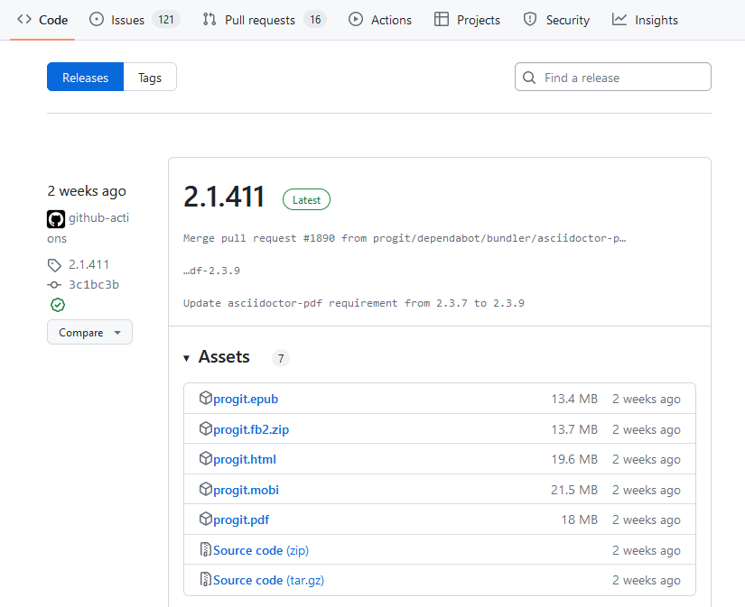
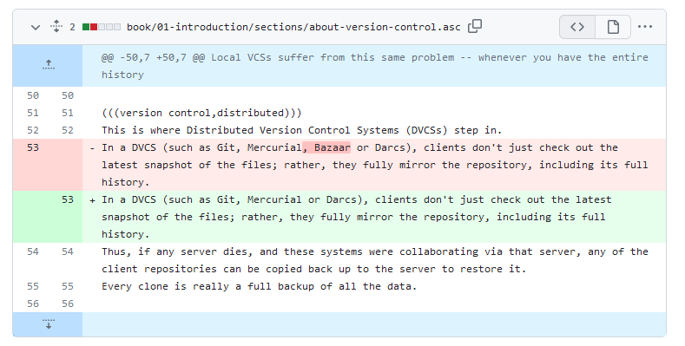
Open Source Development
Manage and compare versions -> Tags -> Releases

Slide 11
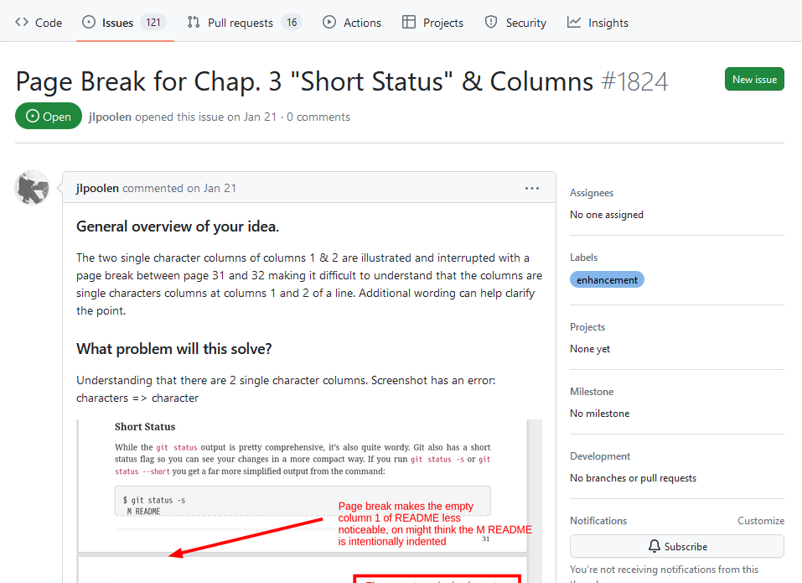
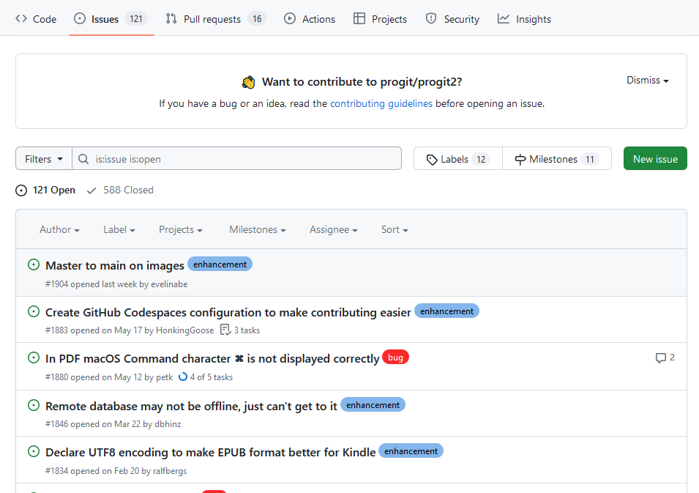
Open Source Development
Task management - All changes are planned and discussed in issues before they are implemented

Slide 12
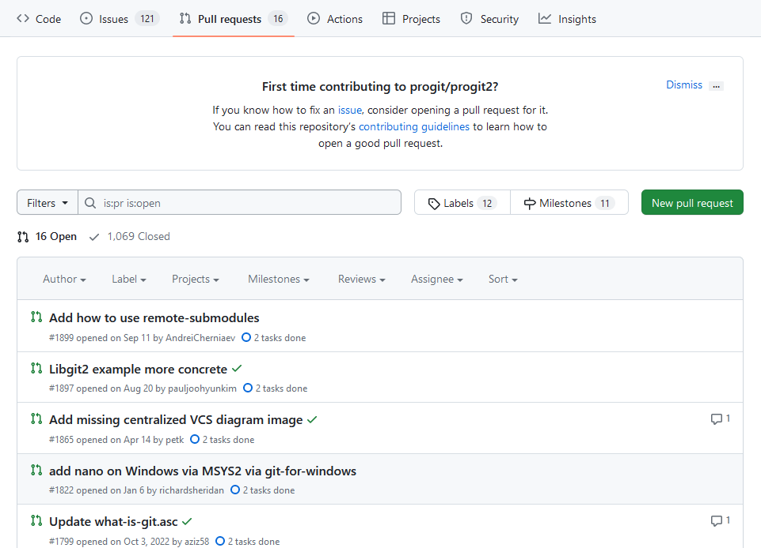
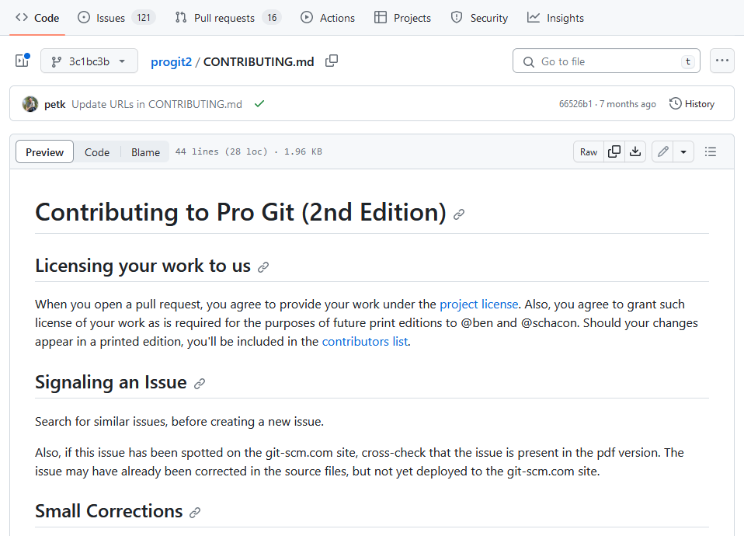
Open Source Development
Coordinated workflows – How to contribute to a project?
Follow contribution guidelines of a project if they exist
Start with description and discussion in issues
Fork, edit and provide change as Pull-Request

Slide 13

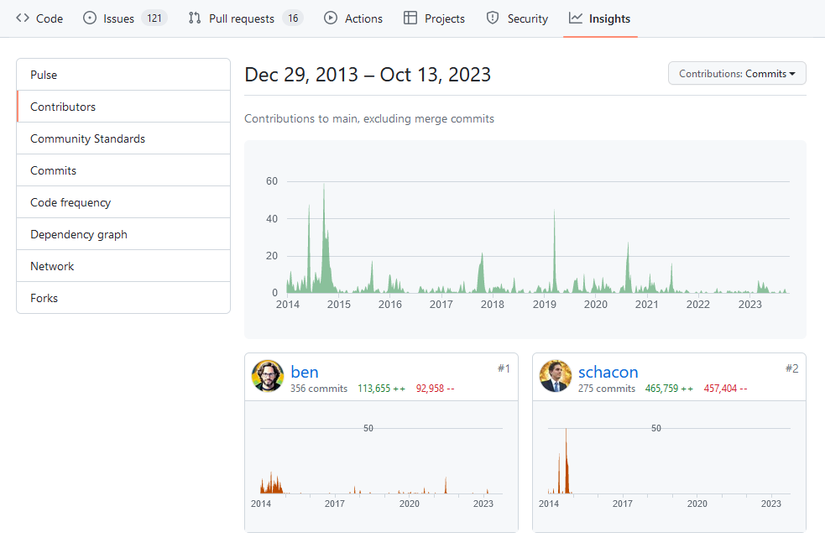
Open Source Development
How many people are interested in your work
Insights e.g. activity over time

Slide 14
Open Source Development
Example of „Pro Git“ shows a great approach for collaboration on Open Textbooks with tools for Open Source Development
… but it's too complicated for beginners to get into collaborative textbook creation and editing with GitHub
Our approach
Create easy to use templates
Provide a Quick Start tutorial and further instructions and a referenceto get started as an author/teacher with GitHub/GitLab

Slide 15
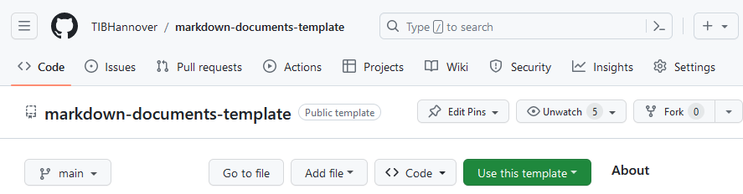
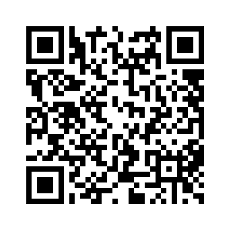
OER GitHub Template
A GitHub template is a repository that can be reused for new repositories
Basic structure for a textbook repository (project)
Similar to „Pro Git“ different output formats e.g. HTML, PDF, EPUB
Contains metadata and gernerates landing page
Extendable with new features e.g. for annotation, transformation with Python scripts
Resusable for new template projects with custom layout/branding e.g. for universities
Could be used for differents kinds of publications e.g. textbooks, articles, thesis, reports

Slide 16
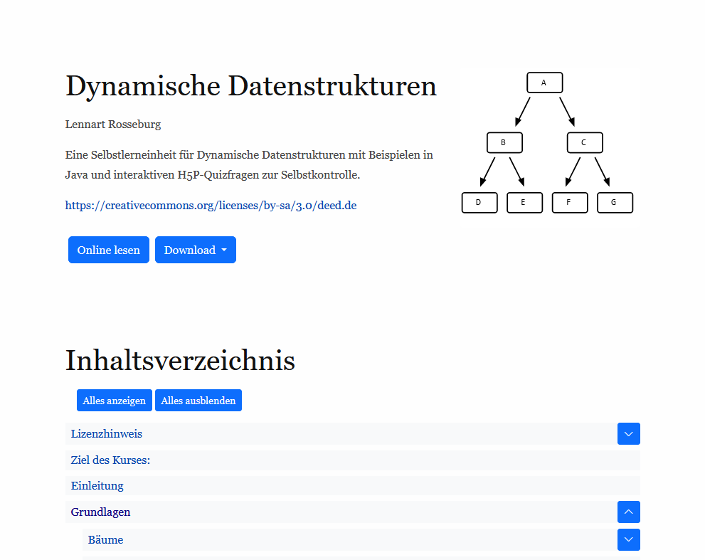
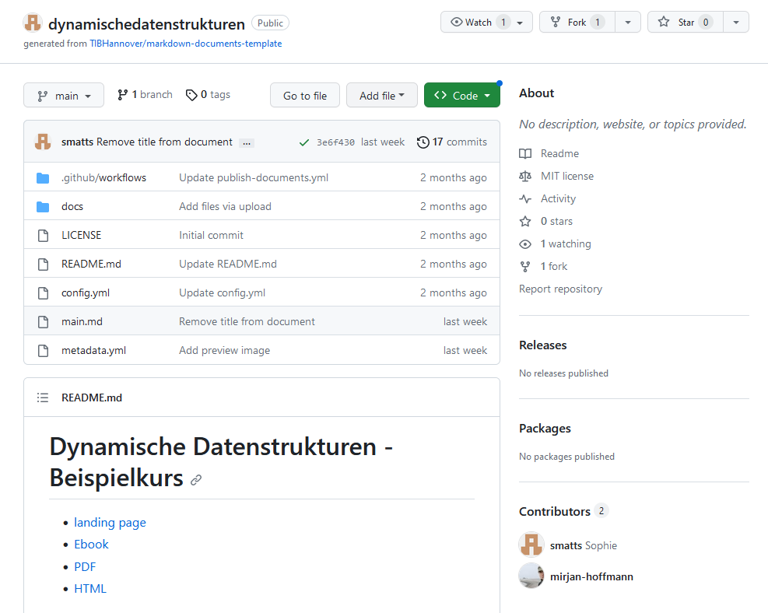
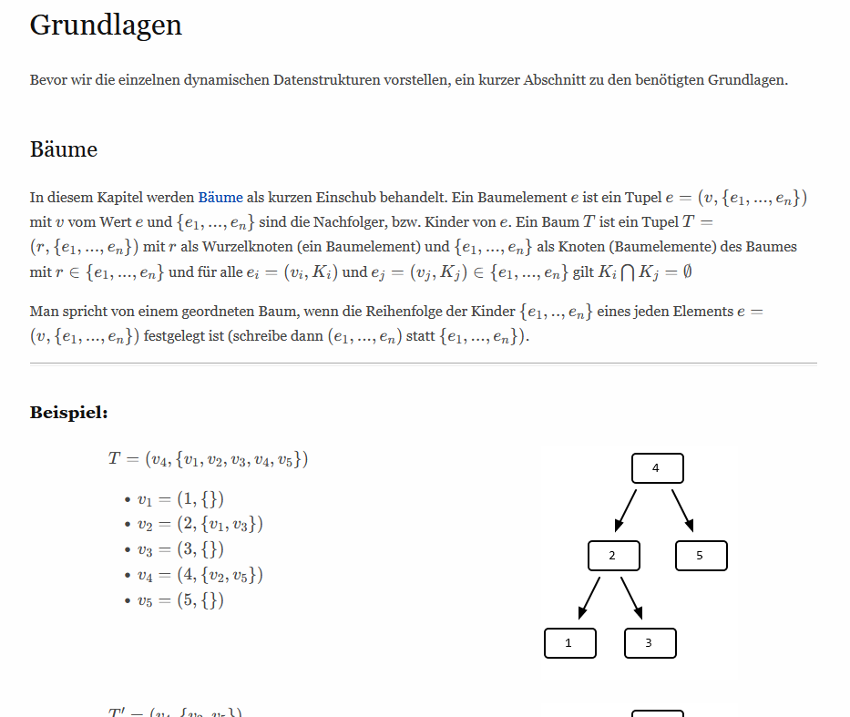
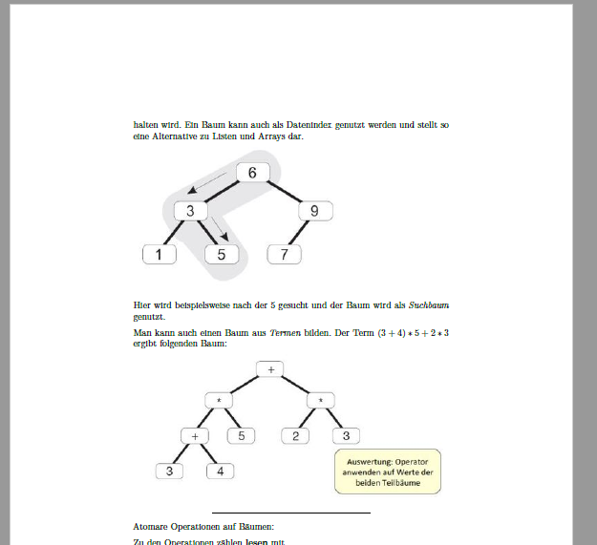
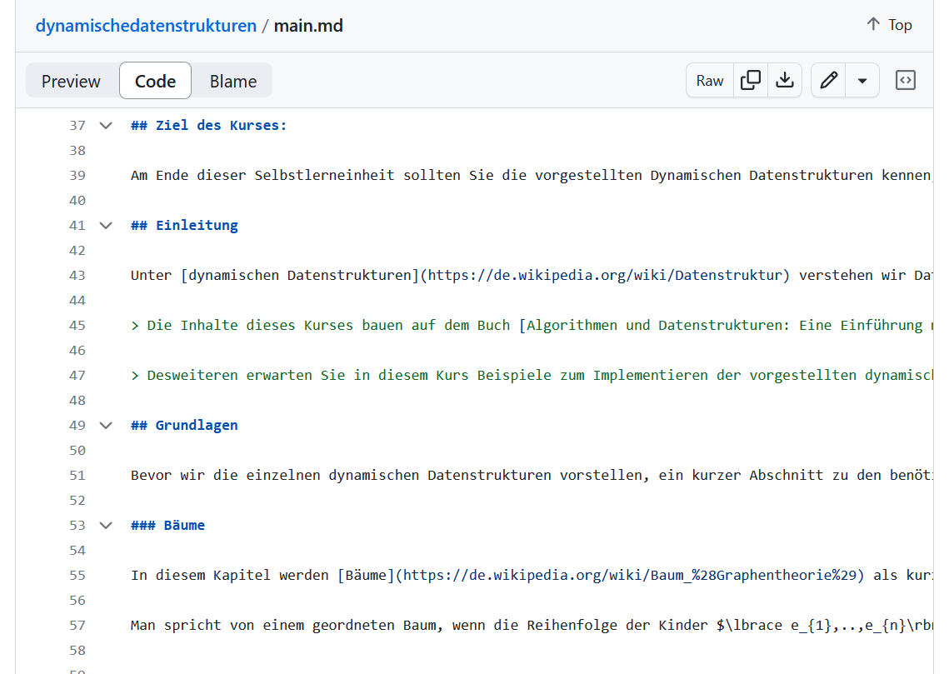
OER GitHub Template
Generate output

Slide 17
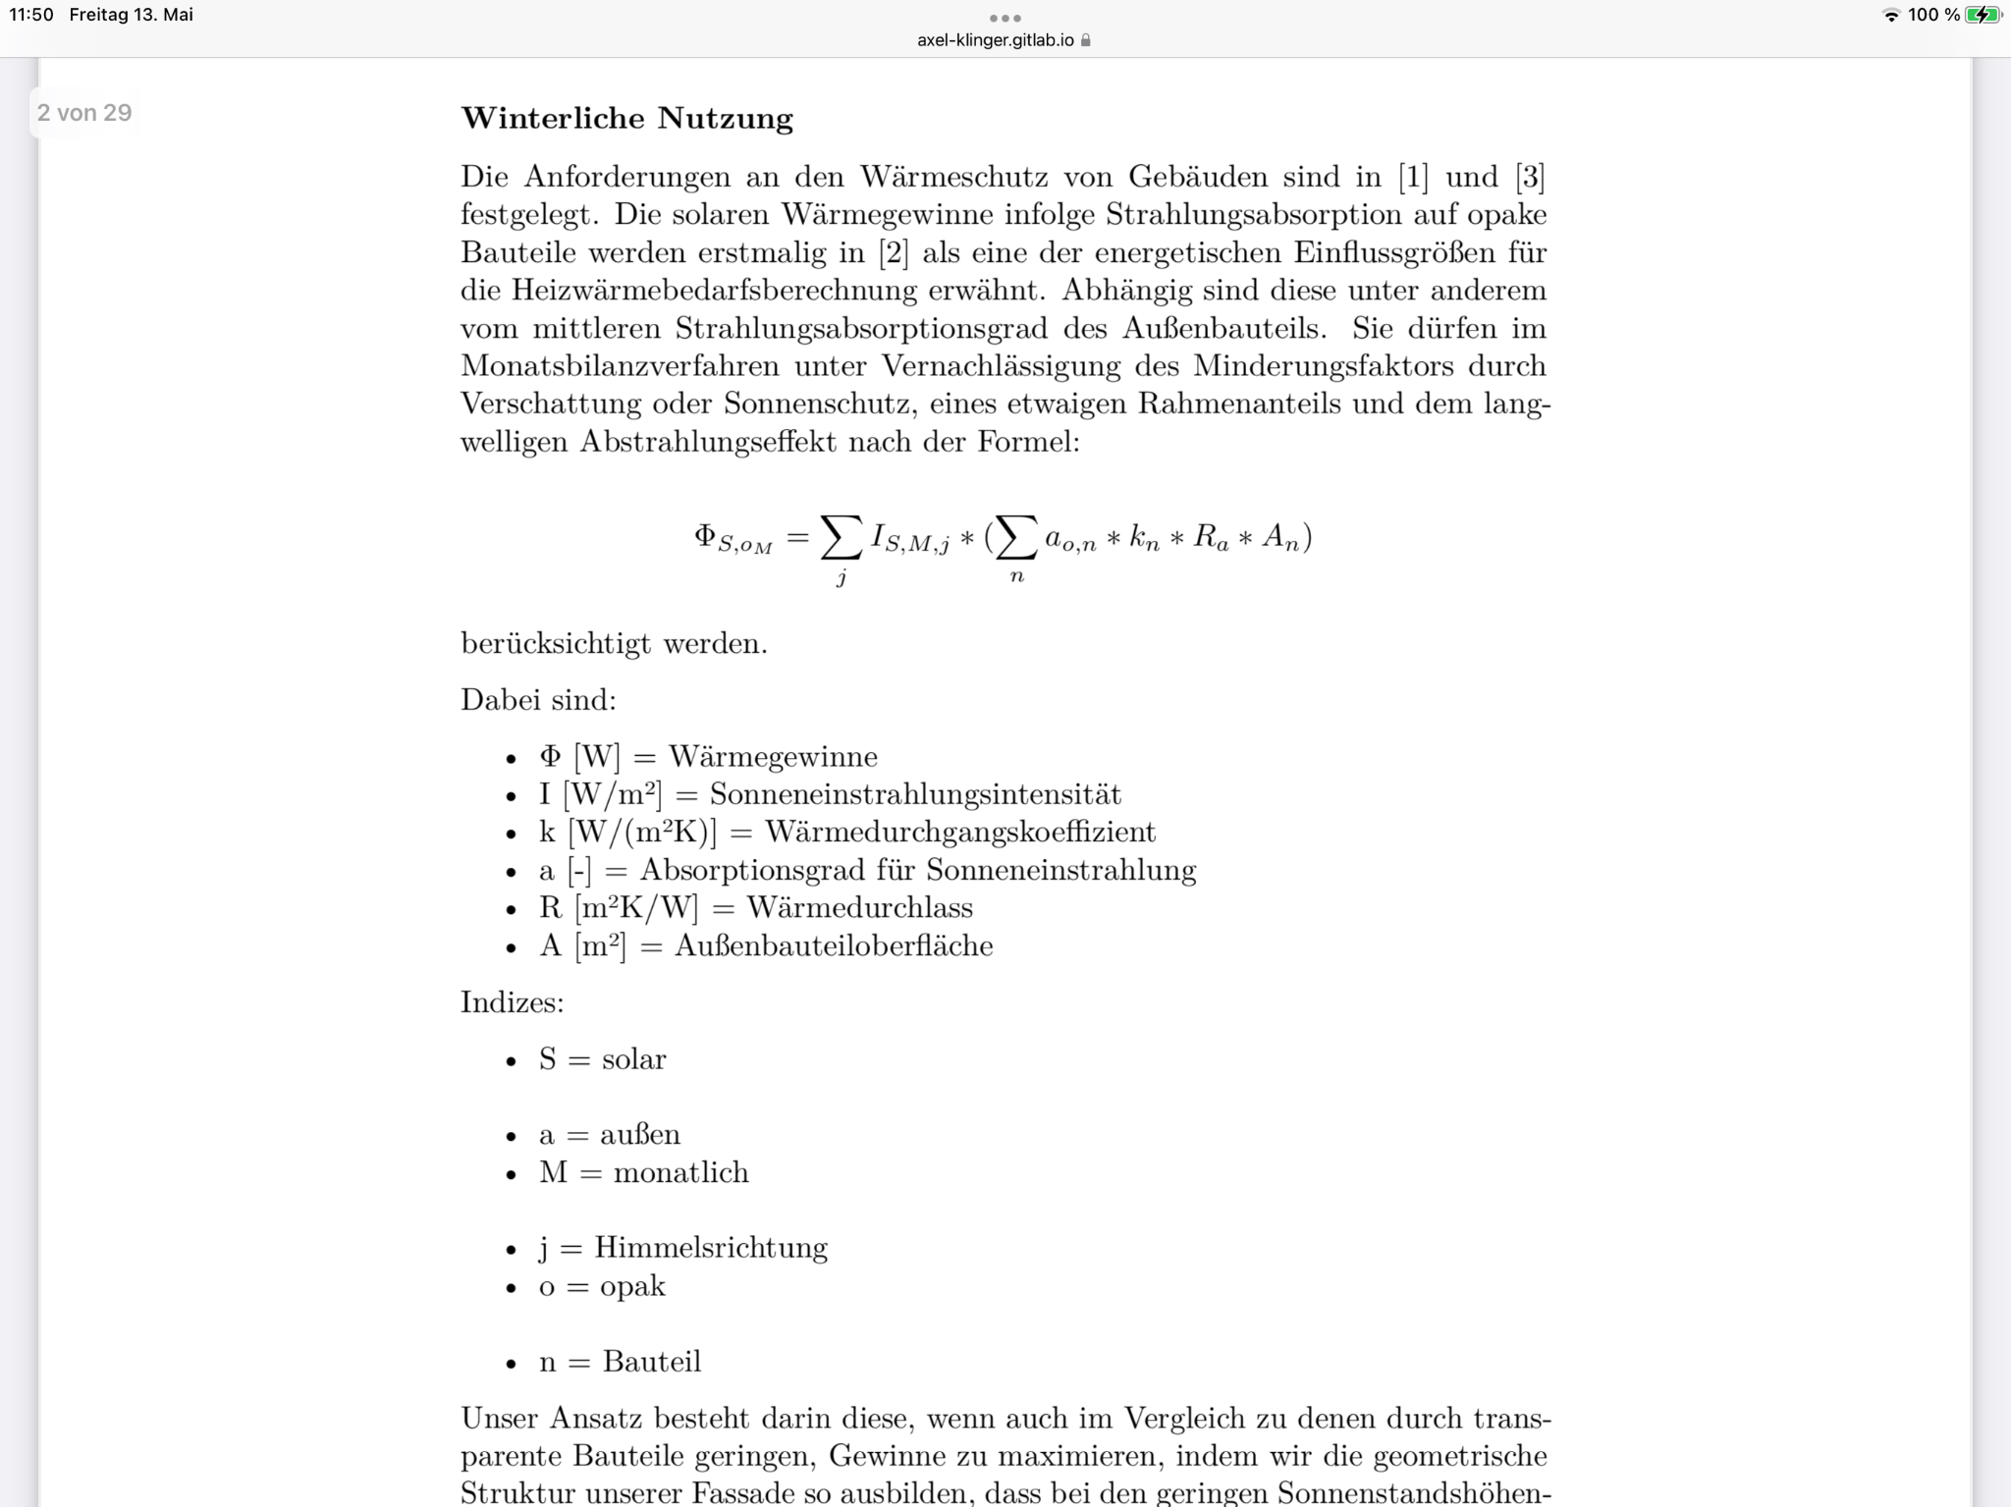
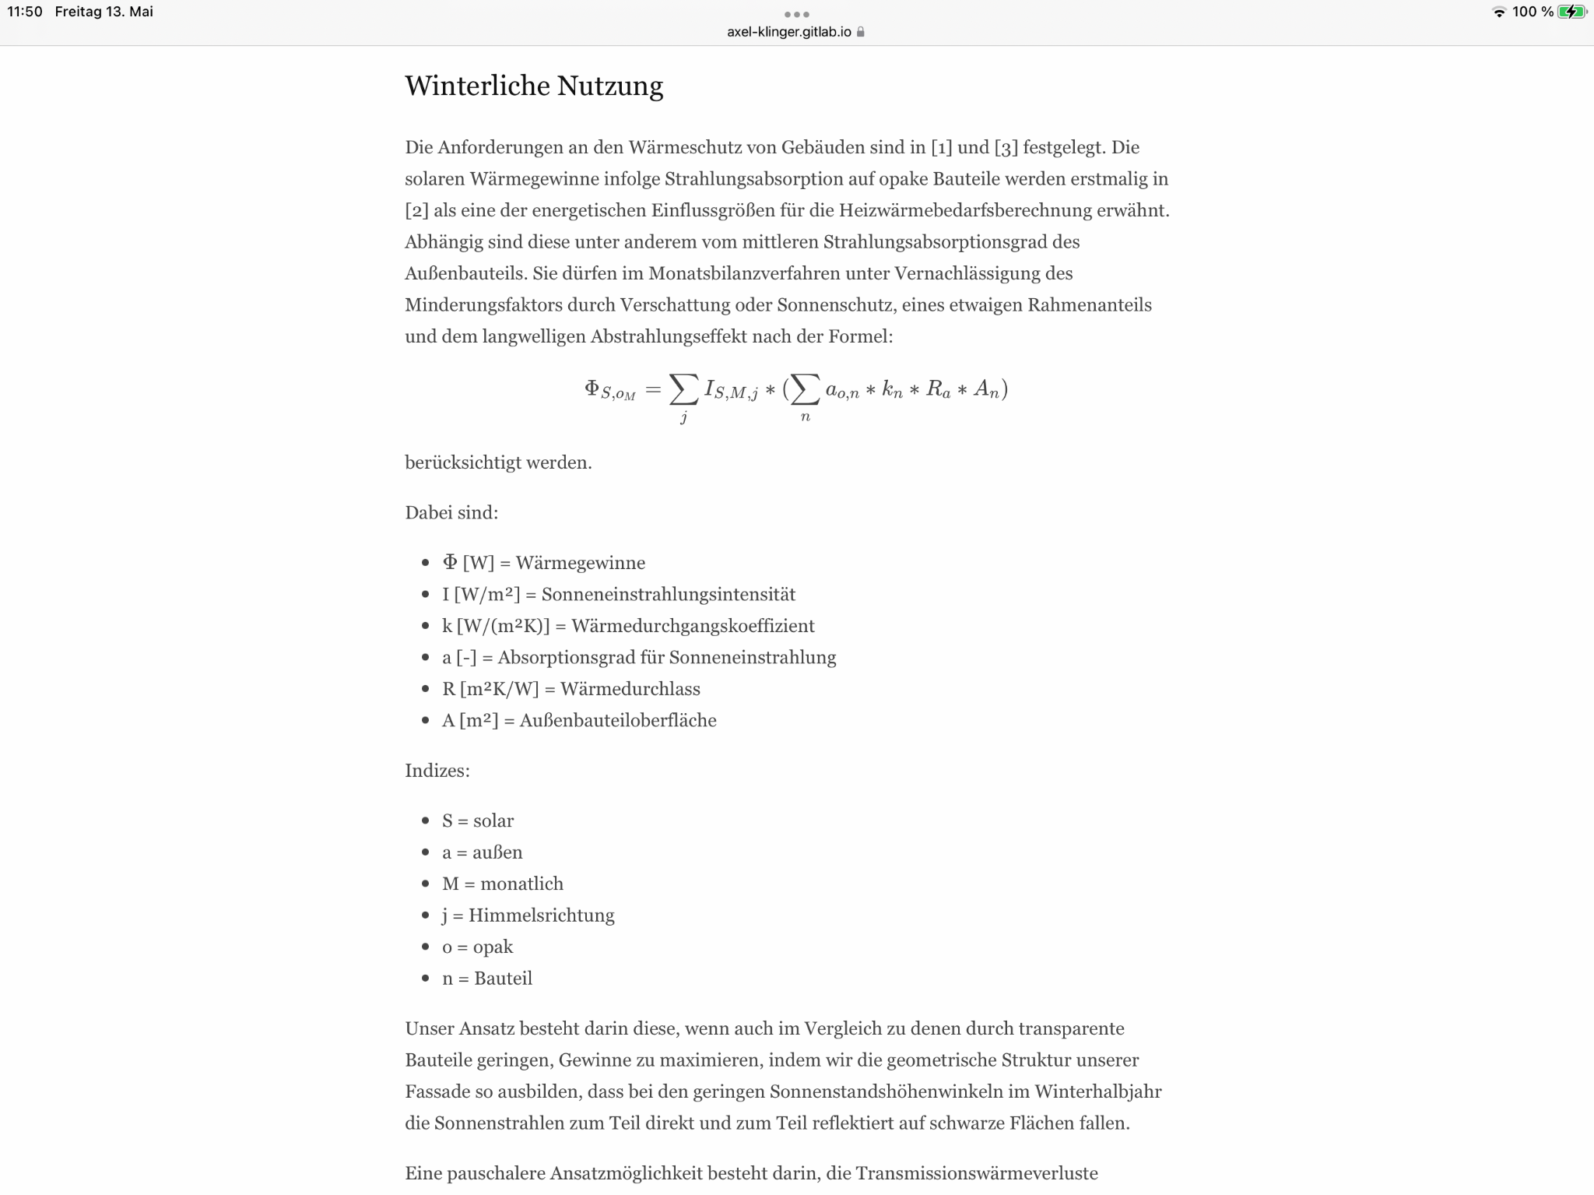
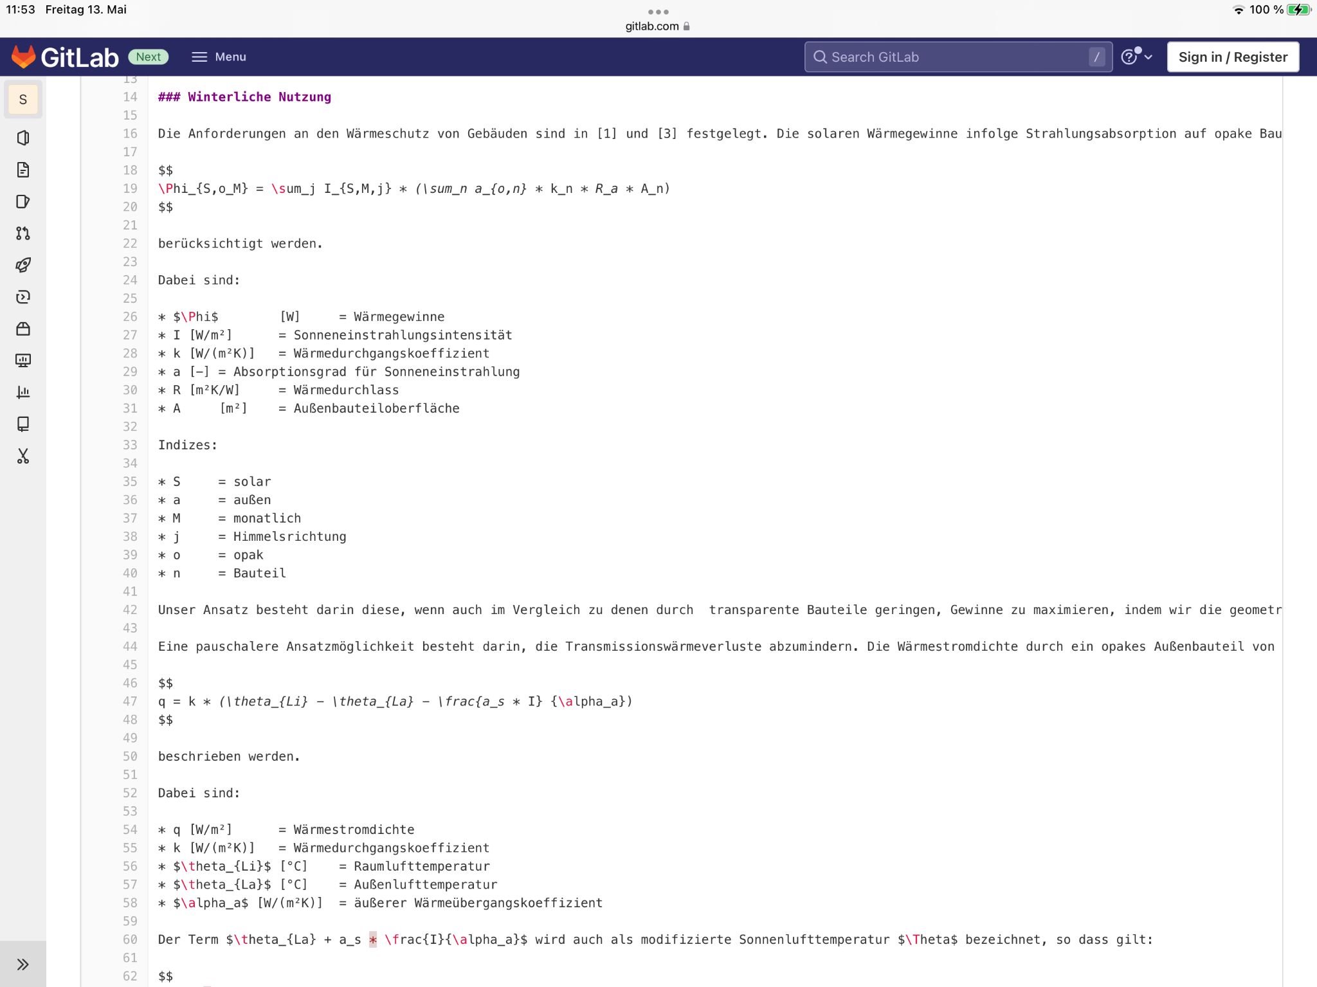
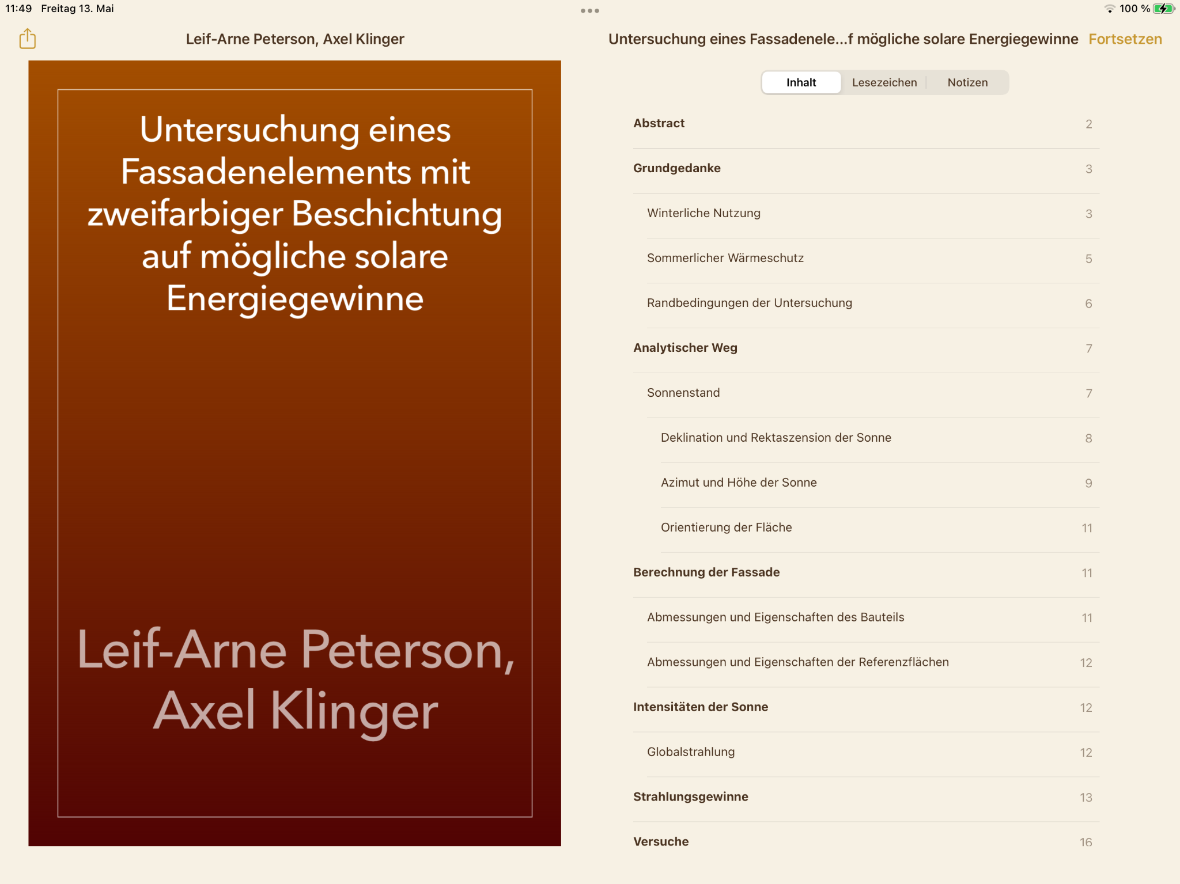
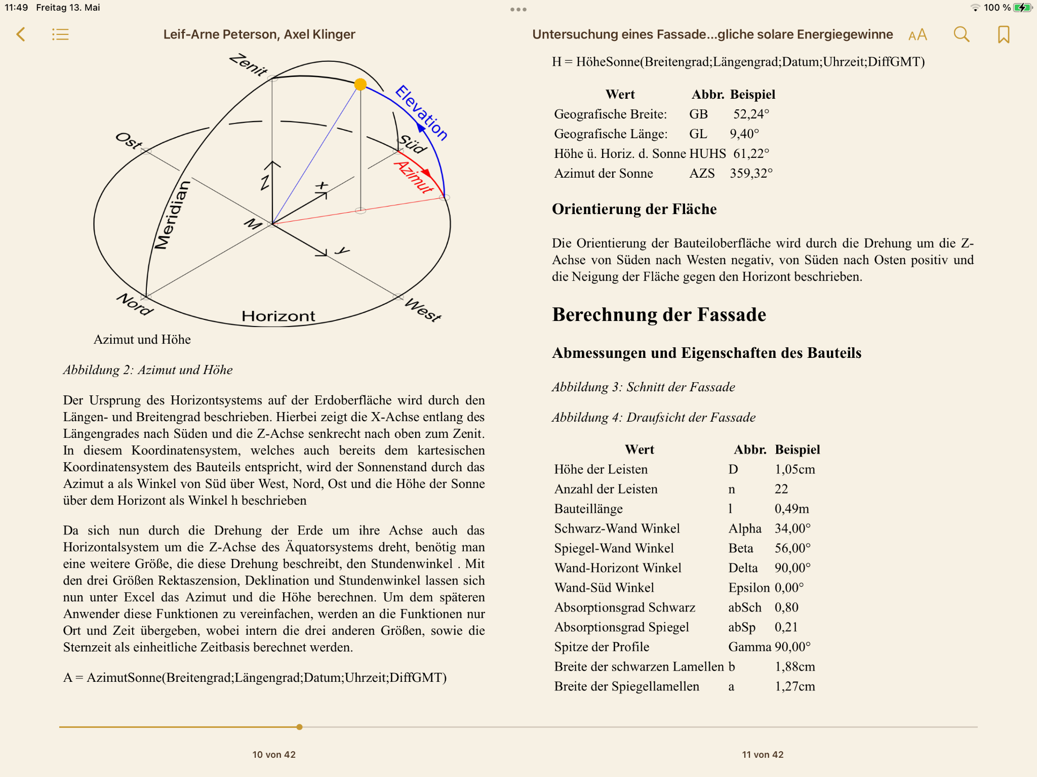
OER GitHub Template
Also applicable for student research projects with output in HTML, PDF, EPUB
https://gitlab.com/axel-klinger/studienarbeit

Slide 18
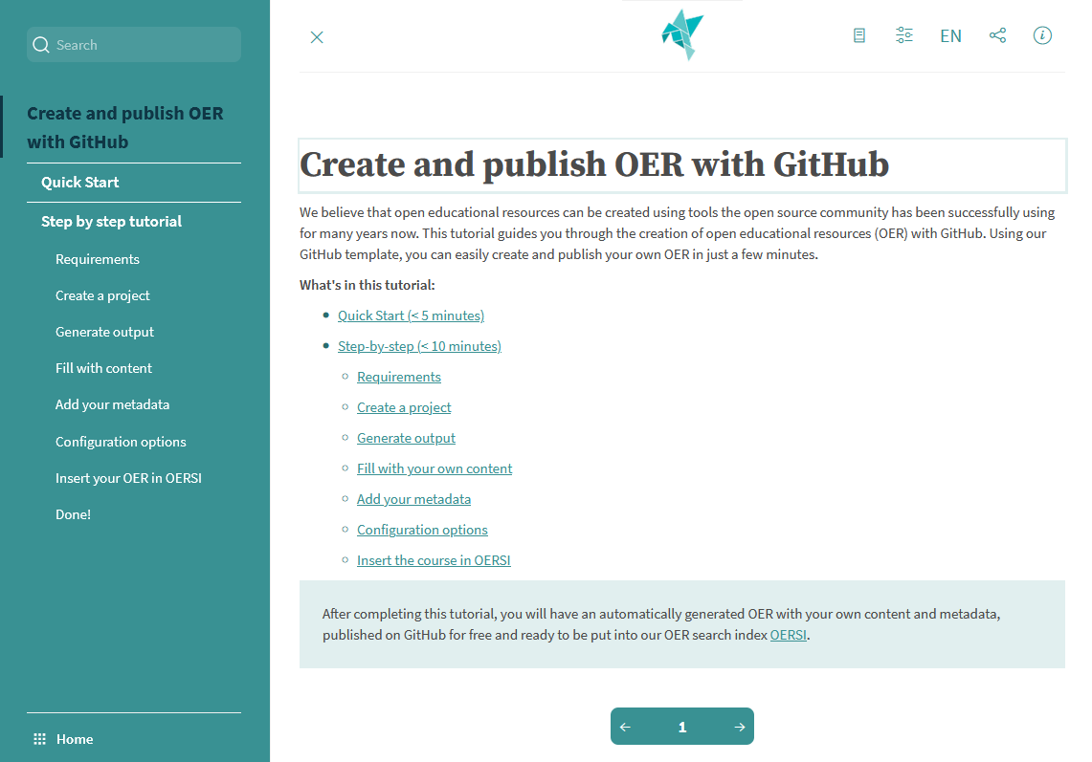
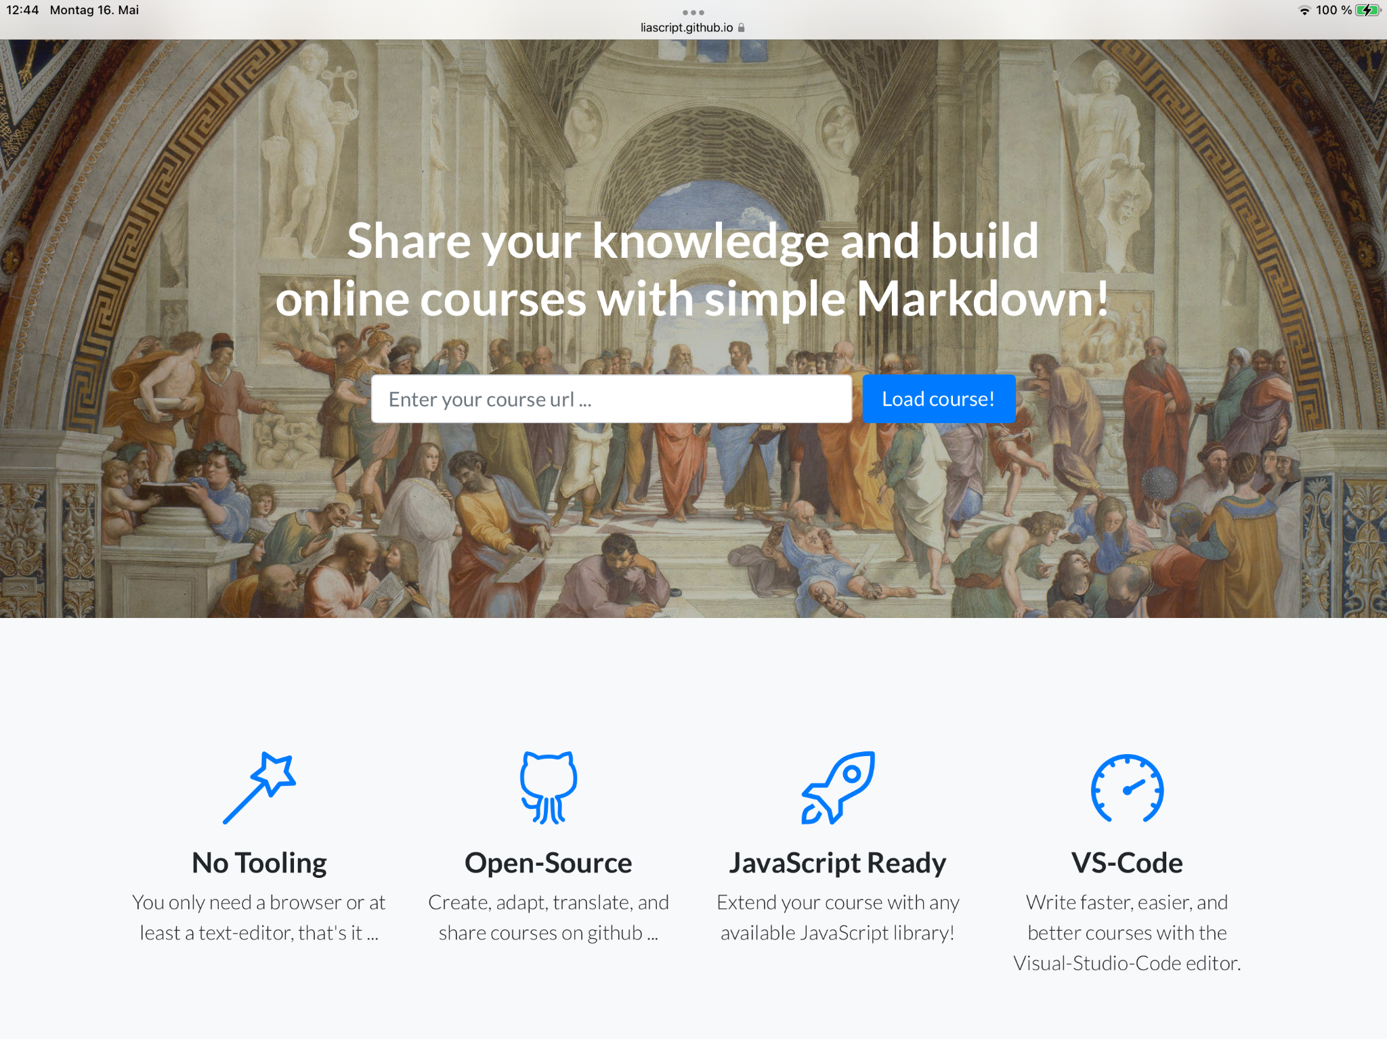
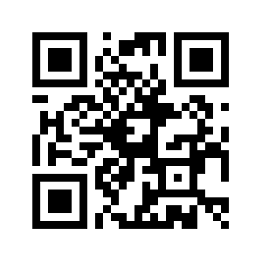
Interactive Courses on GitHub
LiaScript
Very easy to get started, since a text file on GitHub/GitLab alone is sufficient, which is then called and interpreted by the LiaScript page
Many interactive elements for tasks and program execution
Extensive reference and instructions
Good display on all devices

Slide 19
Formats on GitHub
Great for Open Textbooks, Interactive courses, Assesments … and all other plain text based formats
Images and Office Dokuments can be shared on GitHub and GitLab, but they will not show up diffs in the history and history is growing fast!
Not good for Videos, just embed them in text files!
Templates and LiaScript are just two examples – we will introduce other formats in our tutorial, as it grows

Slide 20
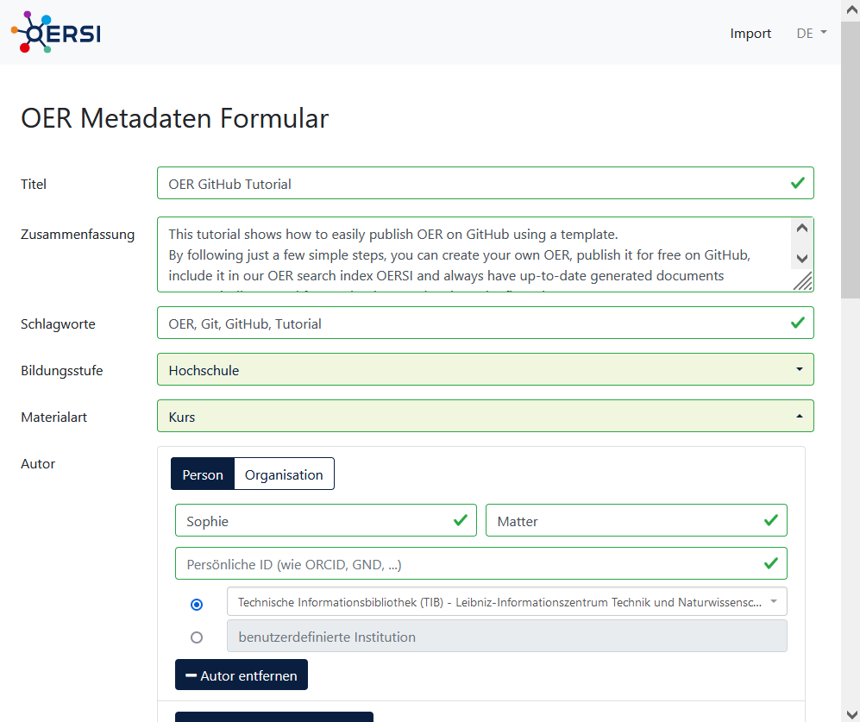
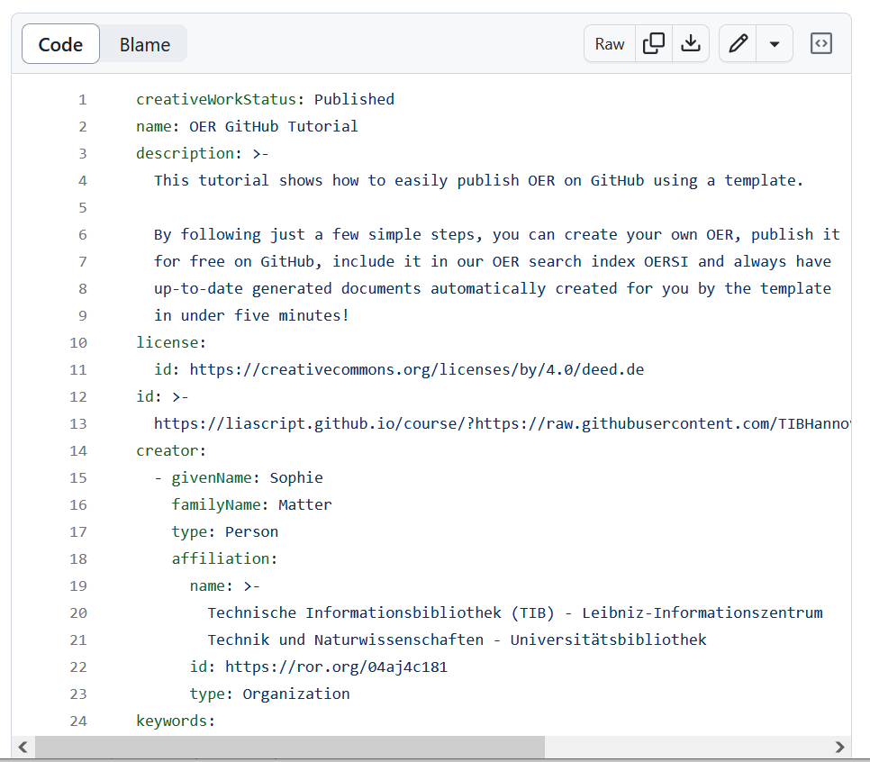
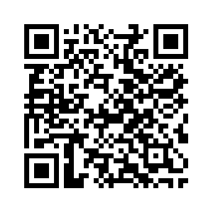
Make it findable!
Tag your GitHub repository as „open-educational-resources“
Add metadata to make it findable by OERSI, Google, other search engines
Use Metadata-Form for Consistent metadata with controlled vacabulary
Google-compliant according to schema.org/CreativeWork
Notes:
– Public vs Published

Slide 21
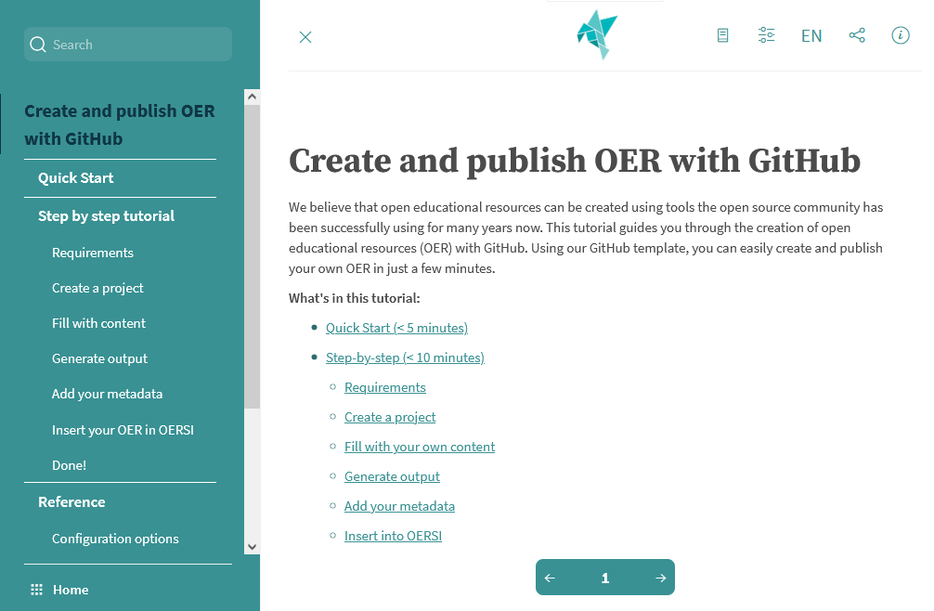
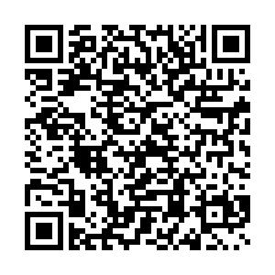
OER Github Tutorial
Quick Start
create a project for Open Textbook on GitHub
make it findable in OERSI … in less than 5min
Step by Step
further description of all steps … in 10-20min
Reference
advanced topics … under construction
Feel free to contribute ;-)

Slide 22
Conclusion
GitHub/GitLab provide a global solution for creation and collaborative development of Open Textbooks and interactive courses without any software or additional infrastructure
Projects from GitHub and GitLab, tagged as „open-educational-resources“ and filled with consistent metadata, will automatically be listed in OERSI

Slide 23

Thanks for your attention!
Contact: axel.klinger@tib.eu
Creative Commons Attribution 4.0 International https://creativecommons.org/licenses/by/4.0/deed.de
Slides

Slide 24
Question of Open
Free to use – e.g. PDF is freely available on the Web
Free to reuse – same but with an open (CC) license
Open Source - PDF and e.g. Word document available with CC license
If I find a PDF and Word document in a repository, how can I contribute to it instead of creating a new (similar) version?
Open for collaboration - all above in open collaboration environment
Public vs published?

Slide 25
GitHub vs GitLab
GitHub is owned by Microsoft and there is just one central instance of GitHub
GitLab is an Open Source Product and beside the central instance it can be hosted locally in an institution or regional computing center
GitHub is easier to start, but all repositories including their issues can also be transferred to any GitLab instance

